Slide 1


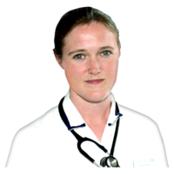


North East & Yorkshire
Learning Disabilities & Autism Programme
Commissioning for the best start in life for disabled children
Monday 16th January 2023, 1pm-3pm
The Leadership Academy, Leeds
To register please contact: england.neylda@nhs.net
Please advise whether joining at the Leadership Academy or via MSTeam.
The conference is for anyone interested in early years support for children with additional needs.
This includes people with a learning disability, autistic people, families of young children with additional needs, commissioners, early years professionals, primary care and ICB professionals and other providers.
What will we cover
What are the barriers and challenges in commissioning for this group?
How do we move from a medico-social model of disability, to a human rights one in our commissioning?
How can training and development support better commissioning for this group?
What skills and knowledge are required for commissioning services for/by commissioners of services for disabled children, and does this differ for different age groups (e.g. under 5, primary etc)
What skills and knowledge are required by others working with young children with disabilities? Social work teams, clinicians, education settings?
What are the knowledge gaps? Law? Policy? Human rights?
How do we harness Universal Personalised Care for this group?

